Slide 1

Empirical Study of Responsiveness with Respect to AWS Regions
Apoorv Agarwal
Omid Pouya
Judson Dressler
Alex Ștefănescu

Slide 2

Assumptions
You run a company website that addresses an audience spread globally but have a small budget.
Have funds for only limited number of instances of your website & back end database.
Goals
Decide optimum placement of an EC2 instance depending on:
Predicted response times from users everywhere
Presumed geographical distribution of users
Maximum cost

Slide 3





System Architecture
…
7 EC2 instances
<http request>
<tracepath>
…
~100 PlanetLab nodes
<timing data>
Coordinator

Slide 4

Data Collection Process
Start EC2 instance running Apache HTTP server in each of 7 AWS regions
Activate PlanetLab nodes around the world
PlanetLab nodes register to coordinator to determine ordering
PlanetLab nodes make HTTP requests every 15min to each EC2 instance for a 1k file and a 128k file
Periodically connect to coordinator and push data

Slide 5
Spreading requests evenly
Coordinator time slot allocation
0
15 min
#4
#2
#5
#1
#6
#3
…
Per host request times
#4
15 min
ec1
ec2
ec3
ec4
ec5
ec6
ec7
15 min
#2
ec1
ec2
ec3
ec4
ec5
ec6
ec7
15 min
#5
ec1
ec2
ec3
ec4
ec5
ec6
ec7
…
…
#3
15 min
ec1
ec2
ec3
ec4
ec5
ec6
ec7
15 min

Slide 6

Experiences with
Data collection from Oct 15 to Nov 5 (20 days)
Over 2 million observations
Total AWS cost ~$16 (for data transfer)
PlanetLab slice with 113 nodes each in different sites
PlanetLab nodes are quite stable
Could not ssh into 7 nodes
Some nodes died every few days and had to be restarted
Average of 102-104 running nodes

Slide 7
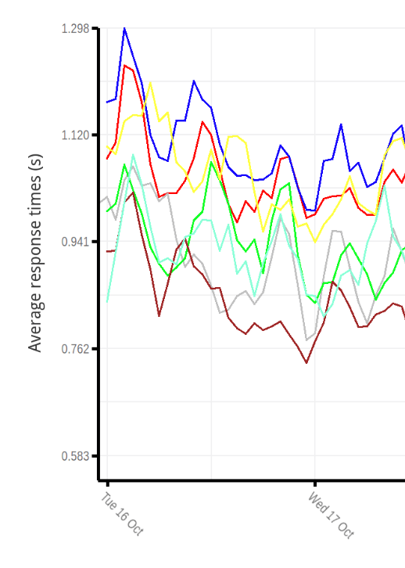
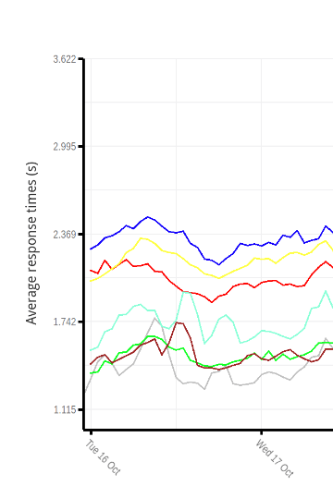
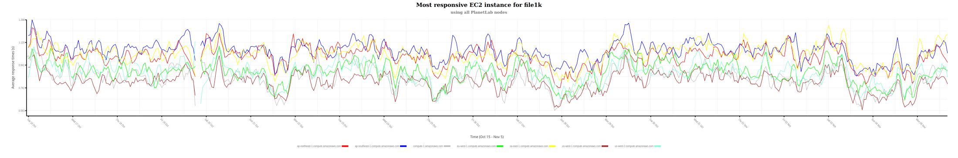
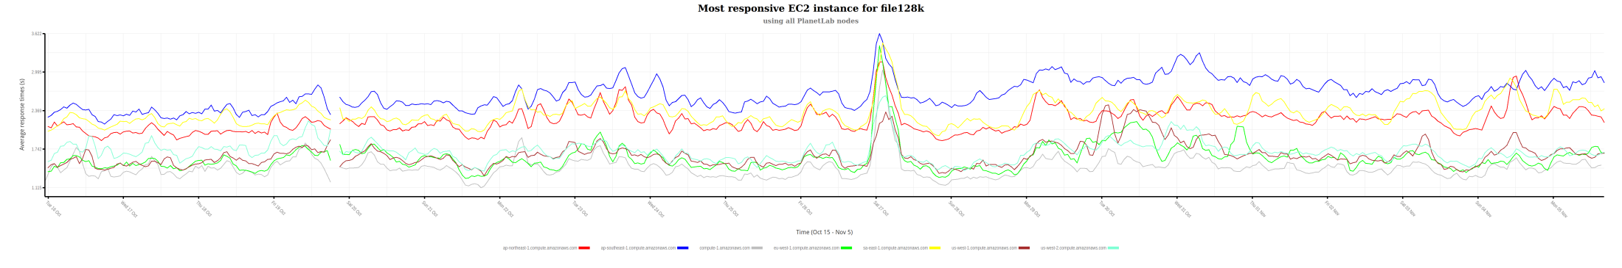
Average response times (all nodes)

Slide 8
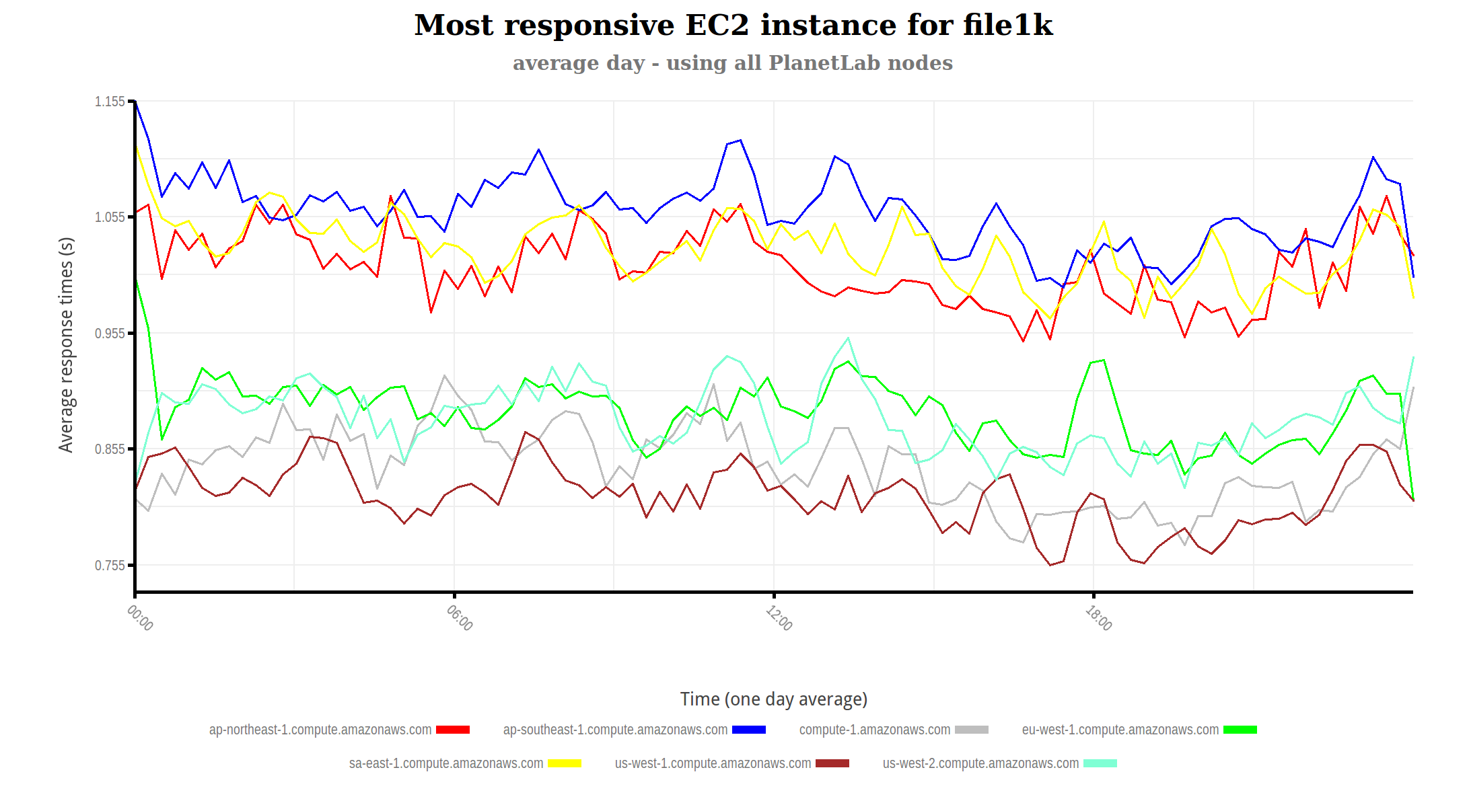
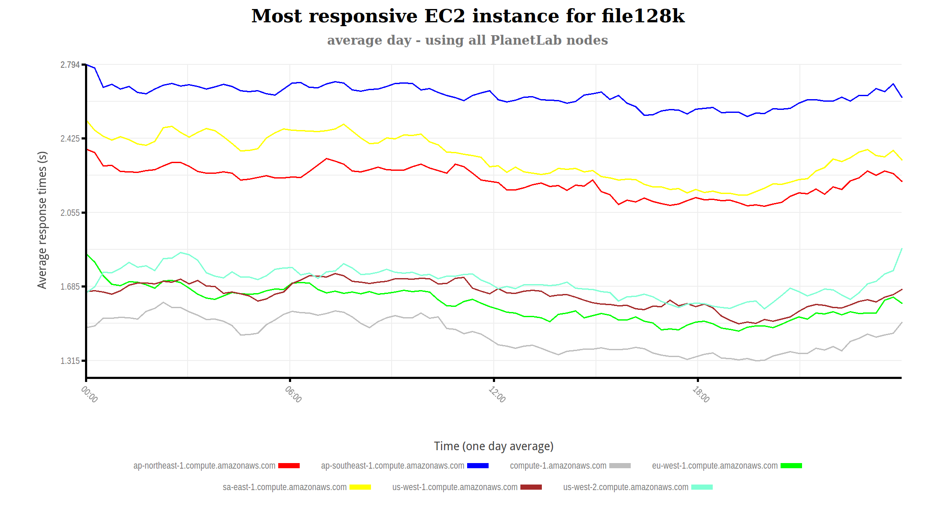
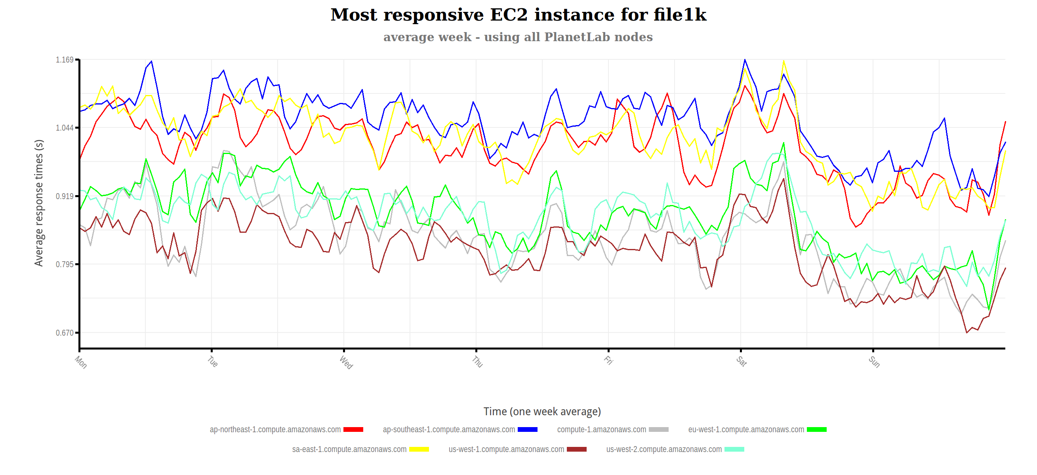
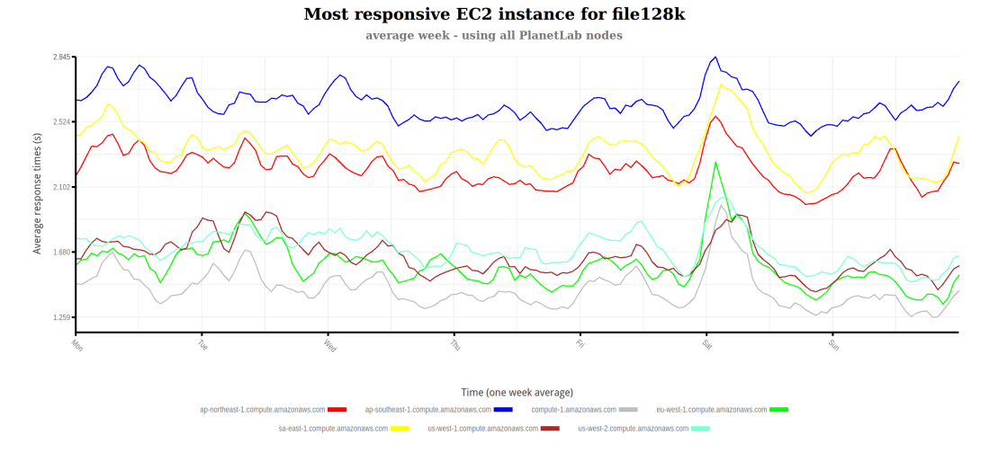
Average day and week (all nodes)
There are no observable night-day or weekend variations

Slide 9
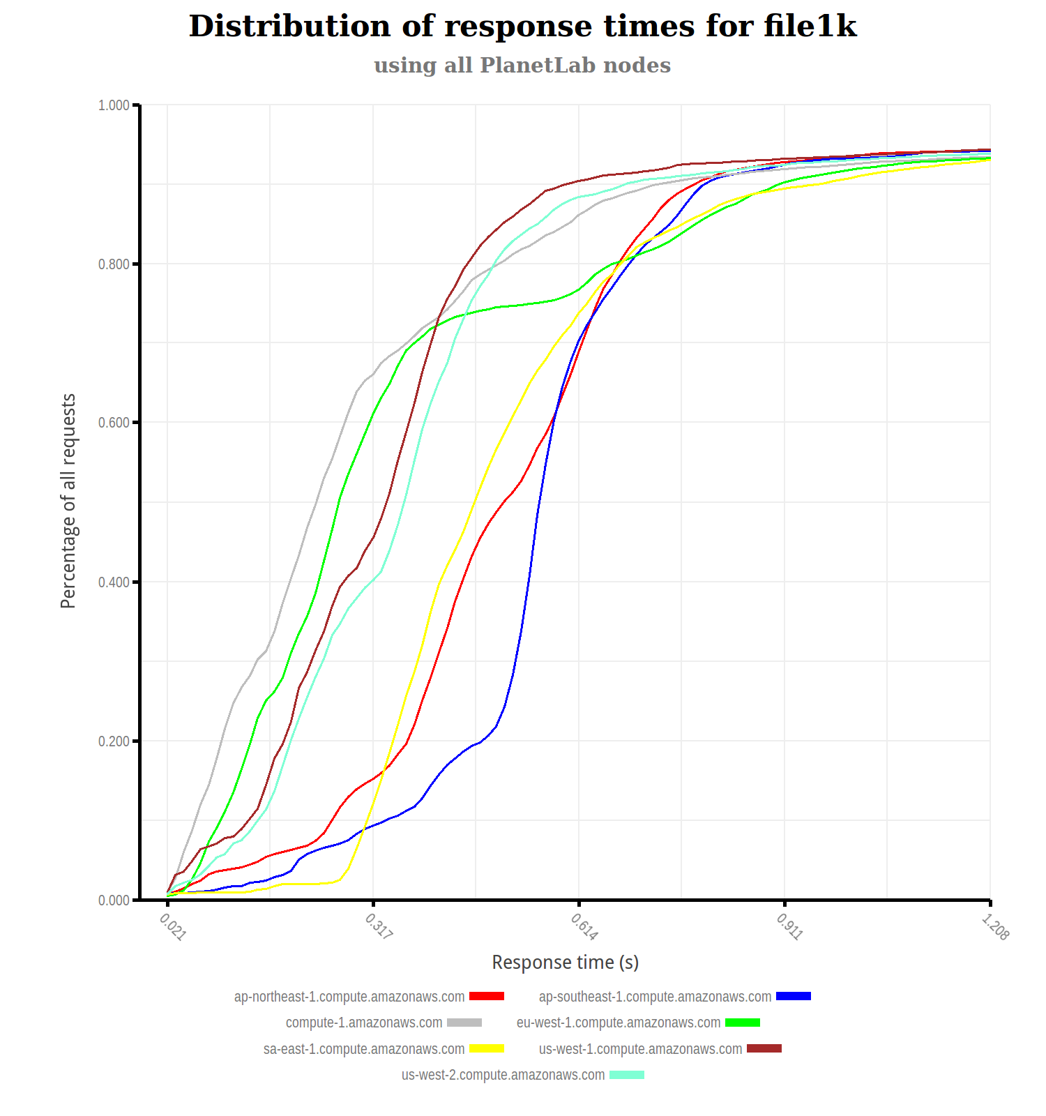
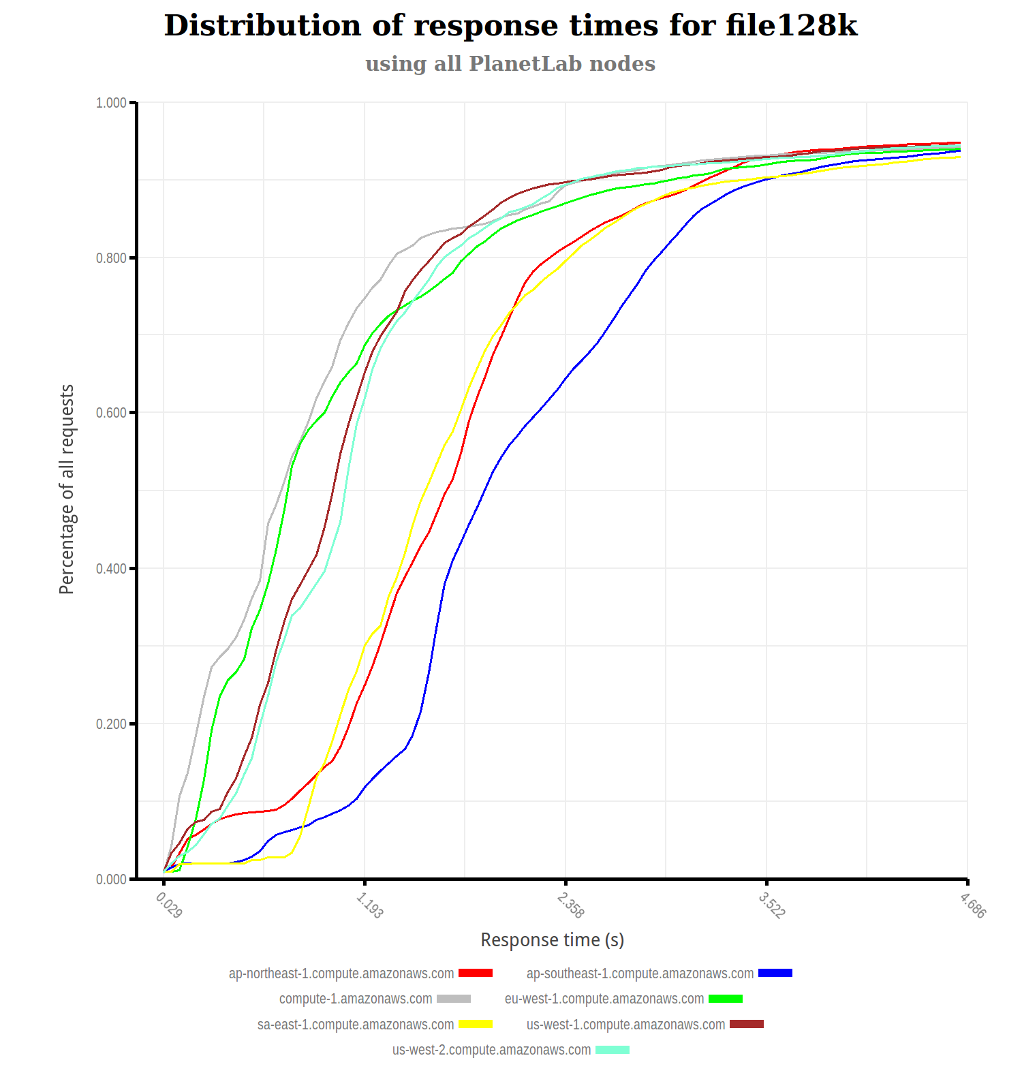
Average response times (all nodes)

Slide 10
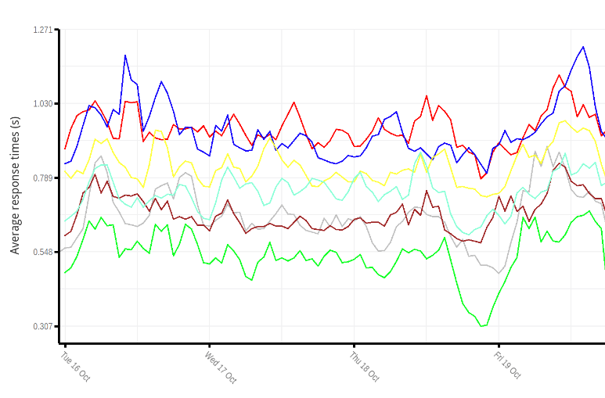
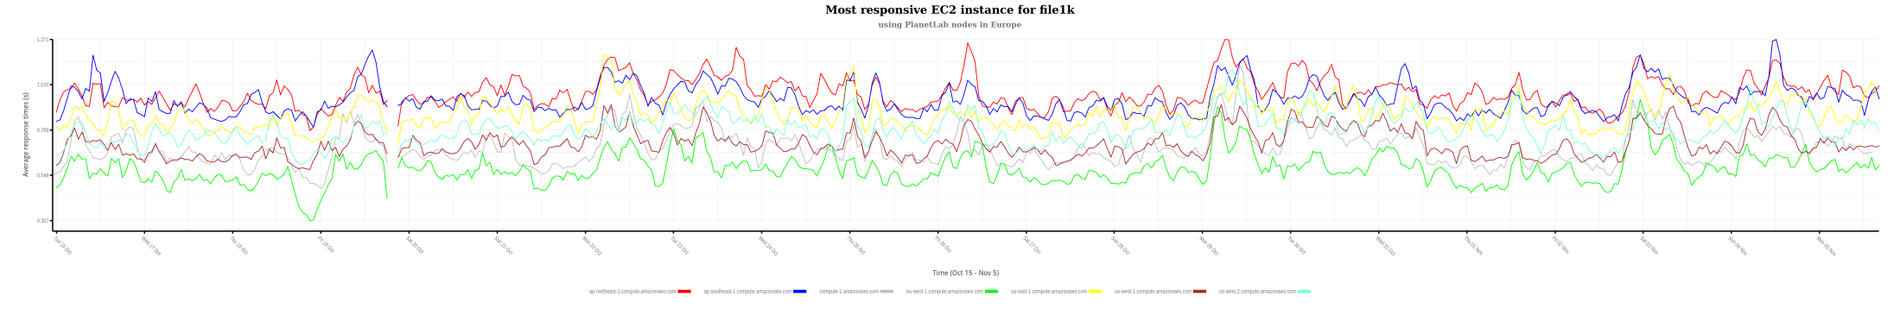
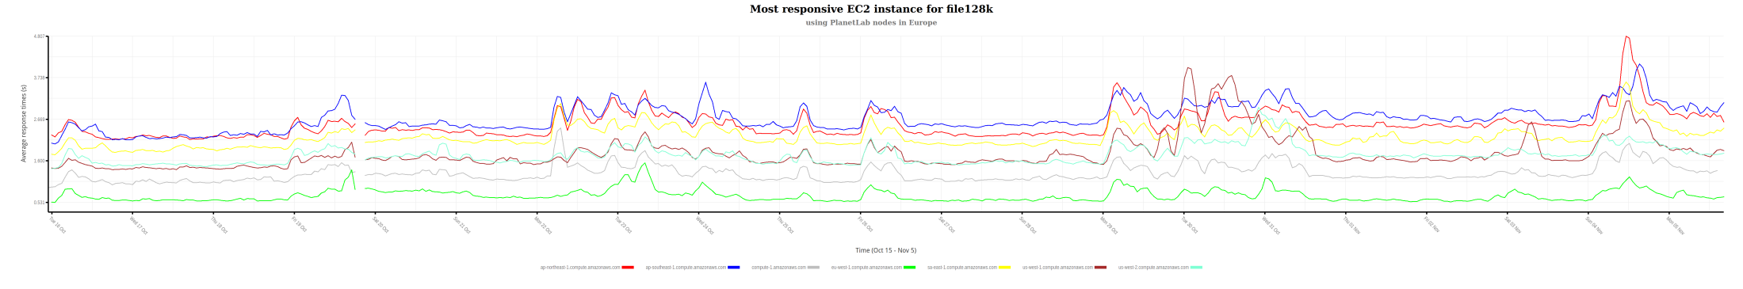
Average response times (European nodes)

Slide 11
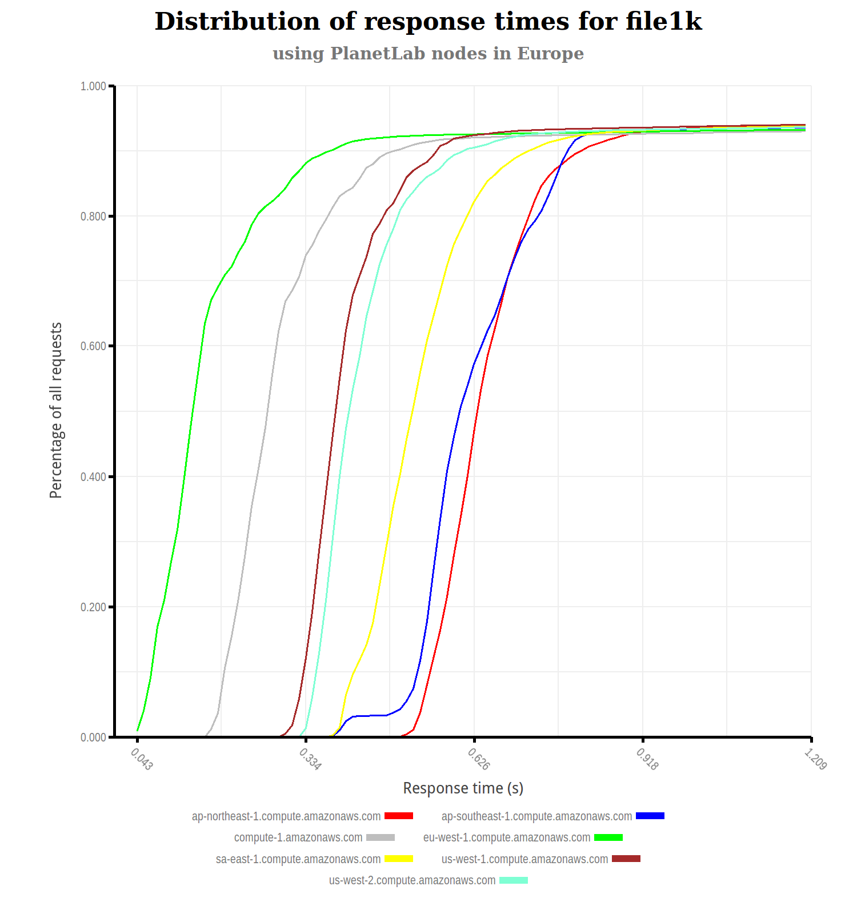
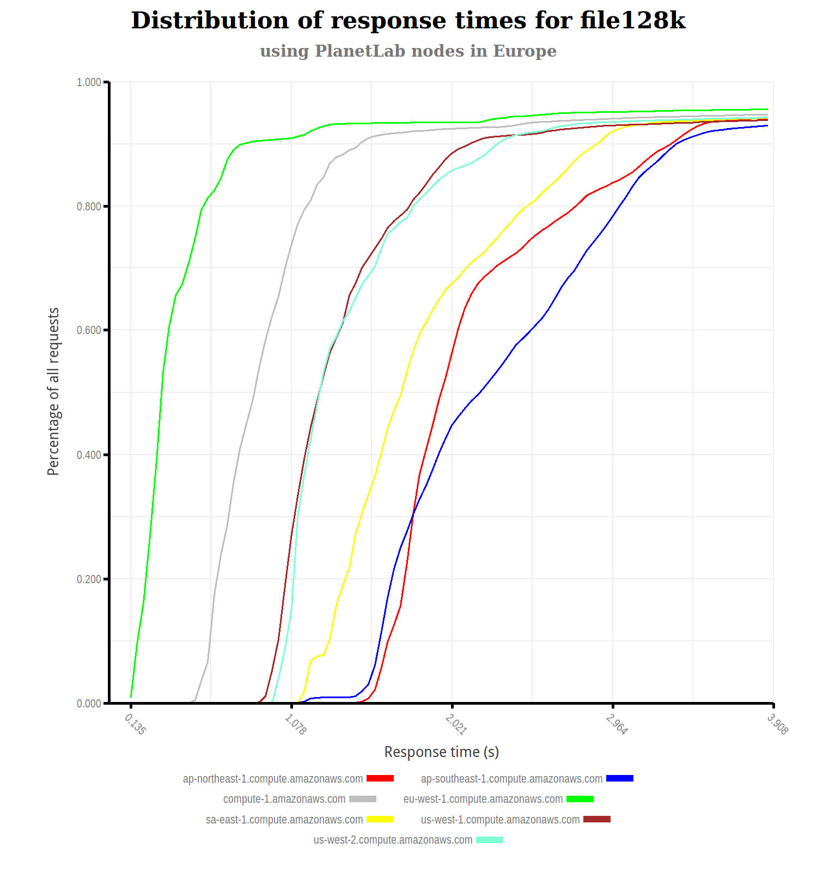
Average response times (European nodes)

Slide 12
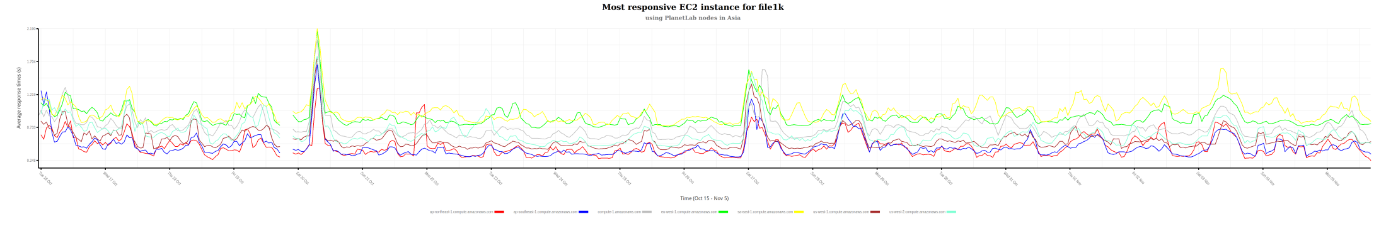
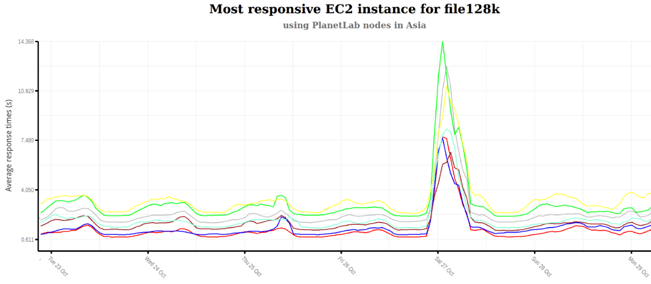
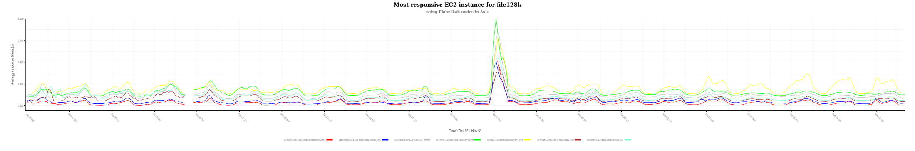
Average response times (Asian nodes)

Slide 13
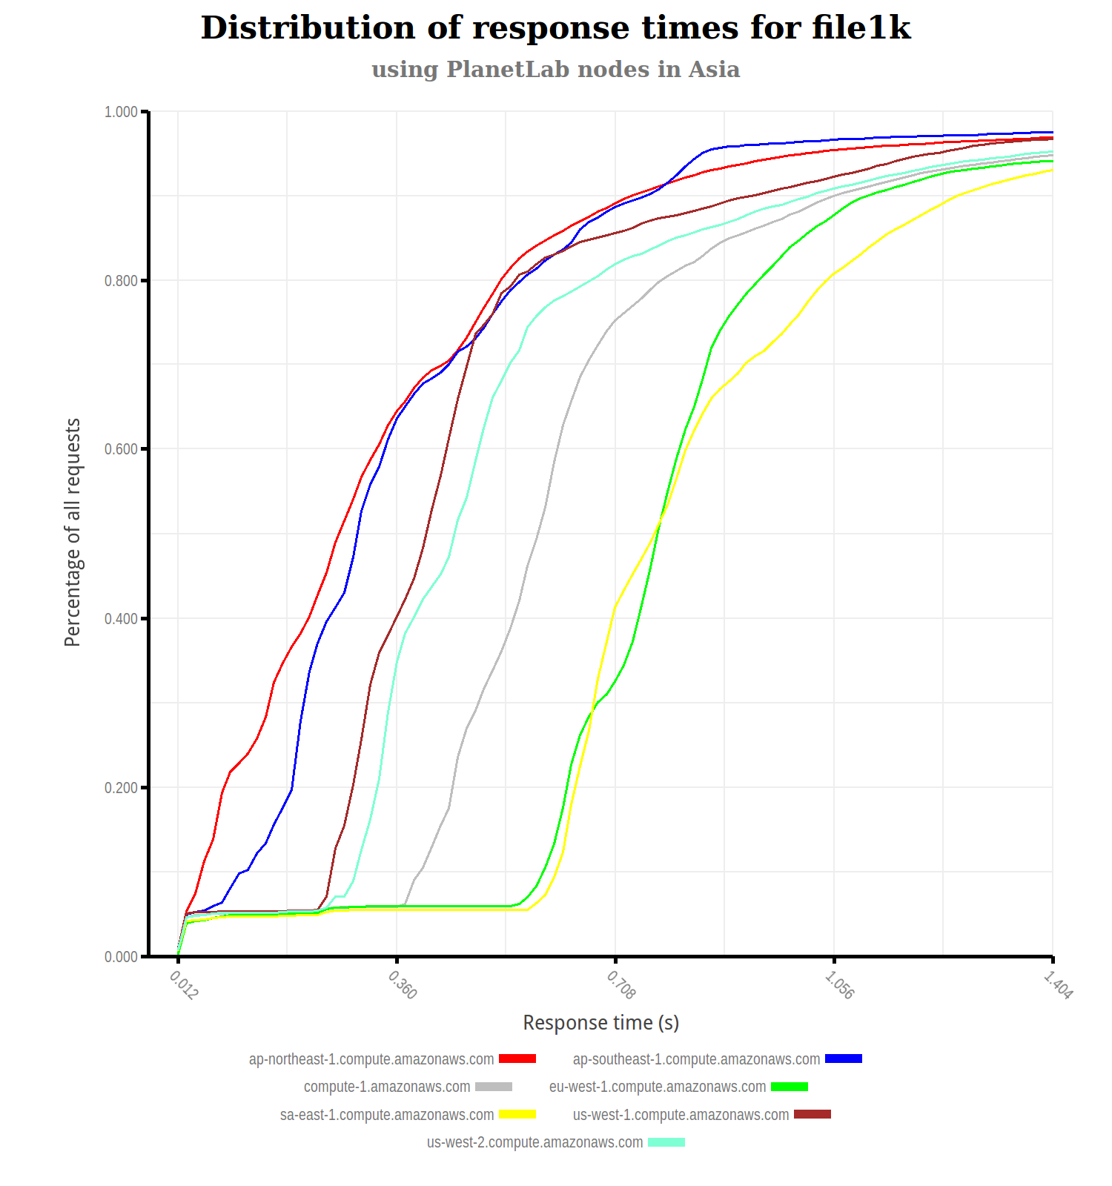
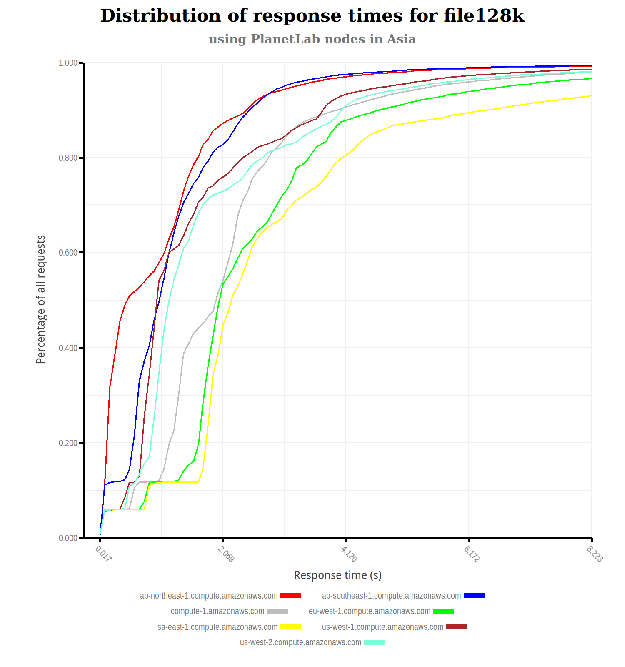
Average response times (Asian nodes)

Slide 14
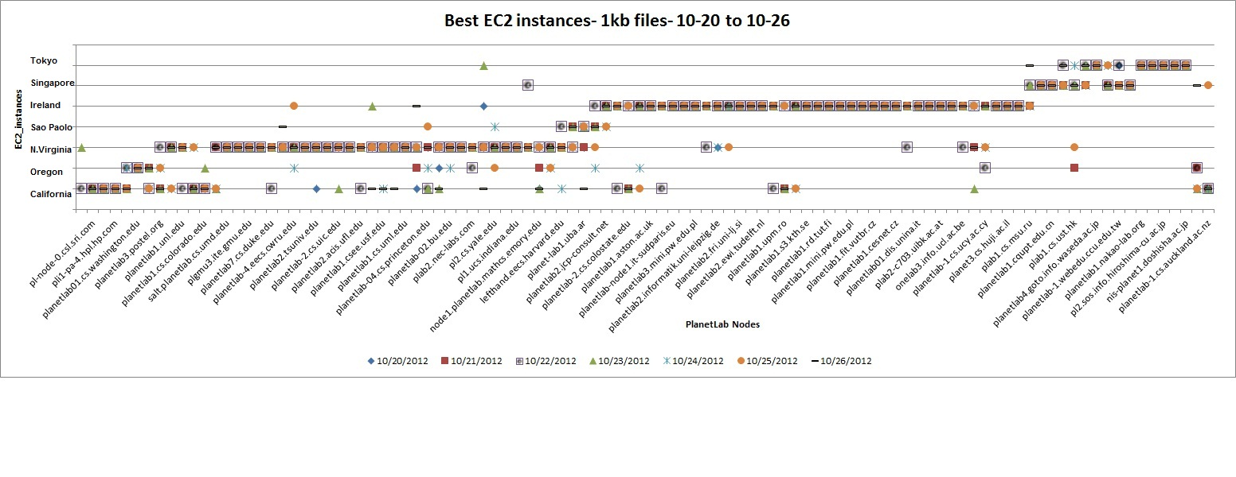
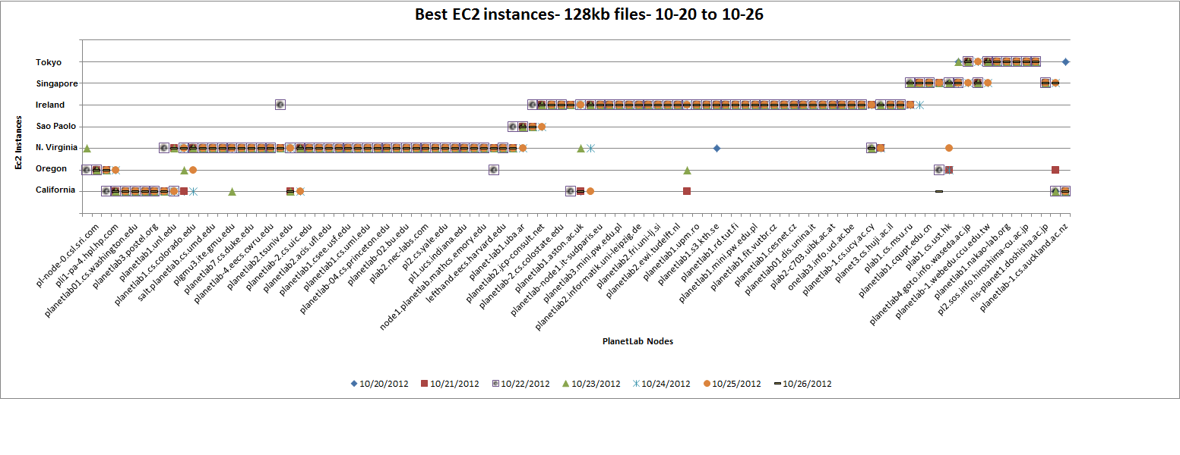
Most responsive instance per PL node

Slide 15
Redistribution of client locations
Our PlanetLab host distribution is imbalanced
North America – 42 nodes
South America – 5 nodes
Europe – 39 nodes
Asia – 18 nodes
A real client distribution might be different
For a particular distribution of clients, which is the most responsive EC2 instance overall?

Slide 16
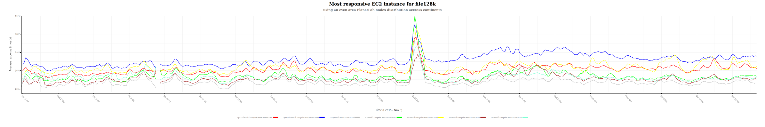
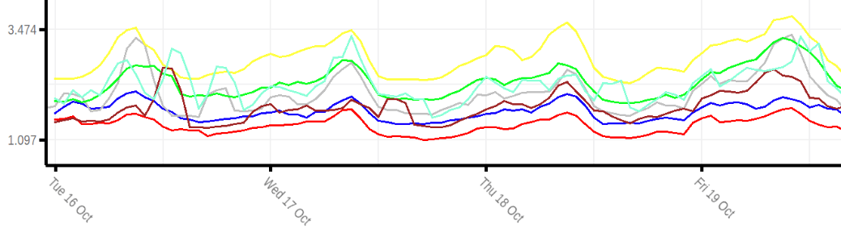
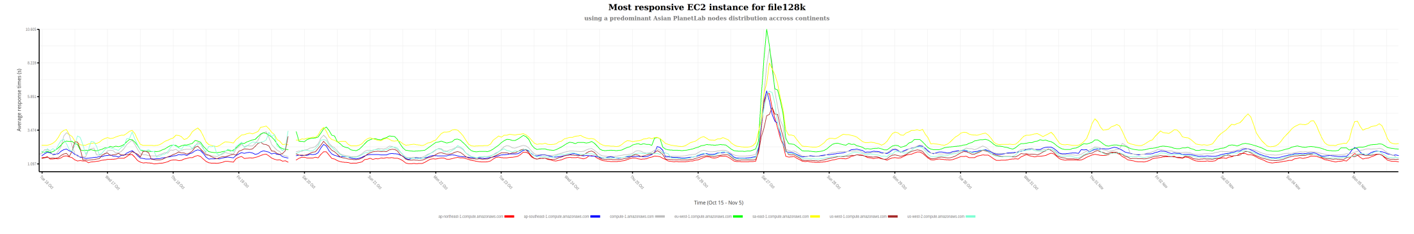
Even node distribution vs. 70% Asian

Slide 17
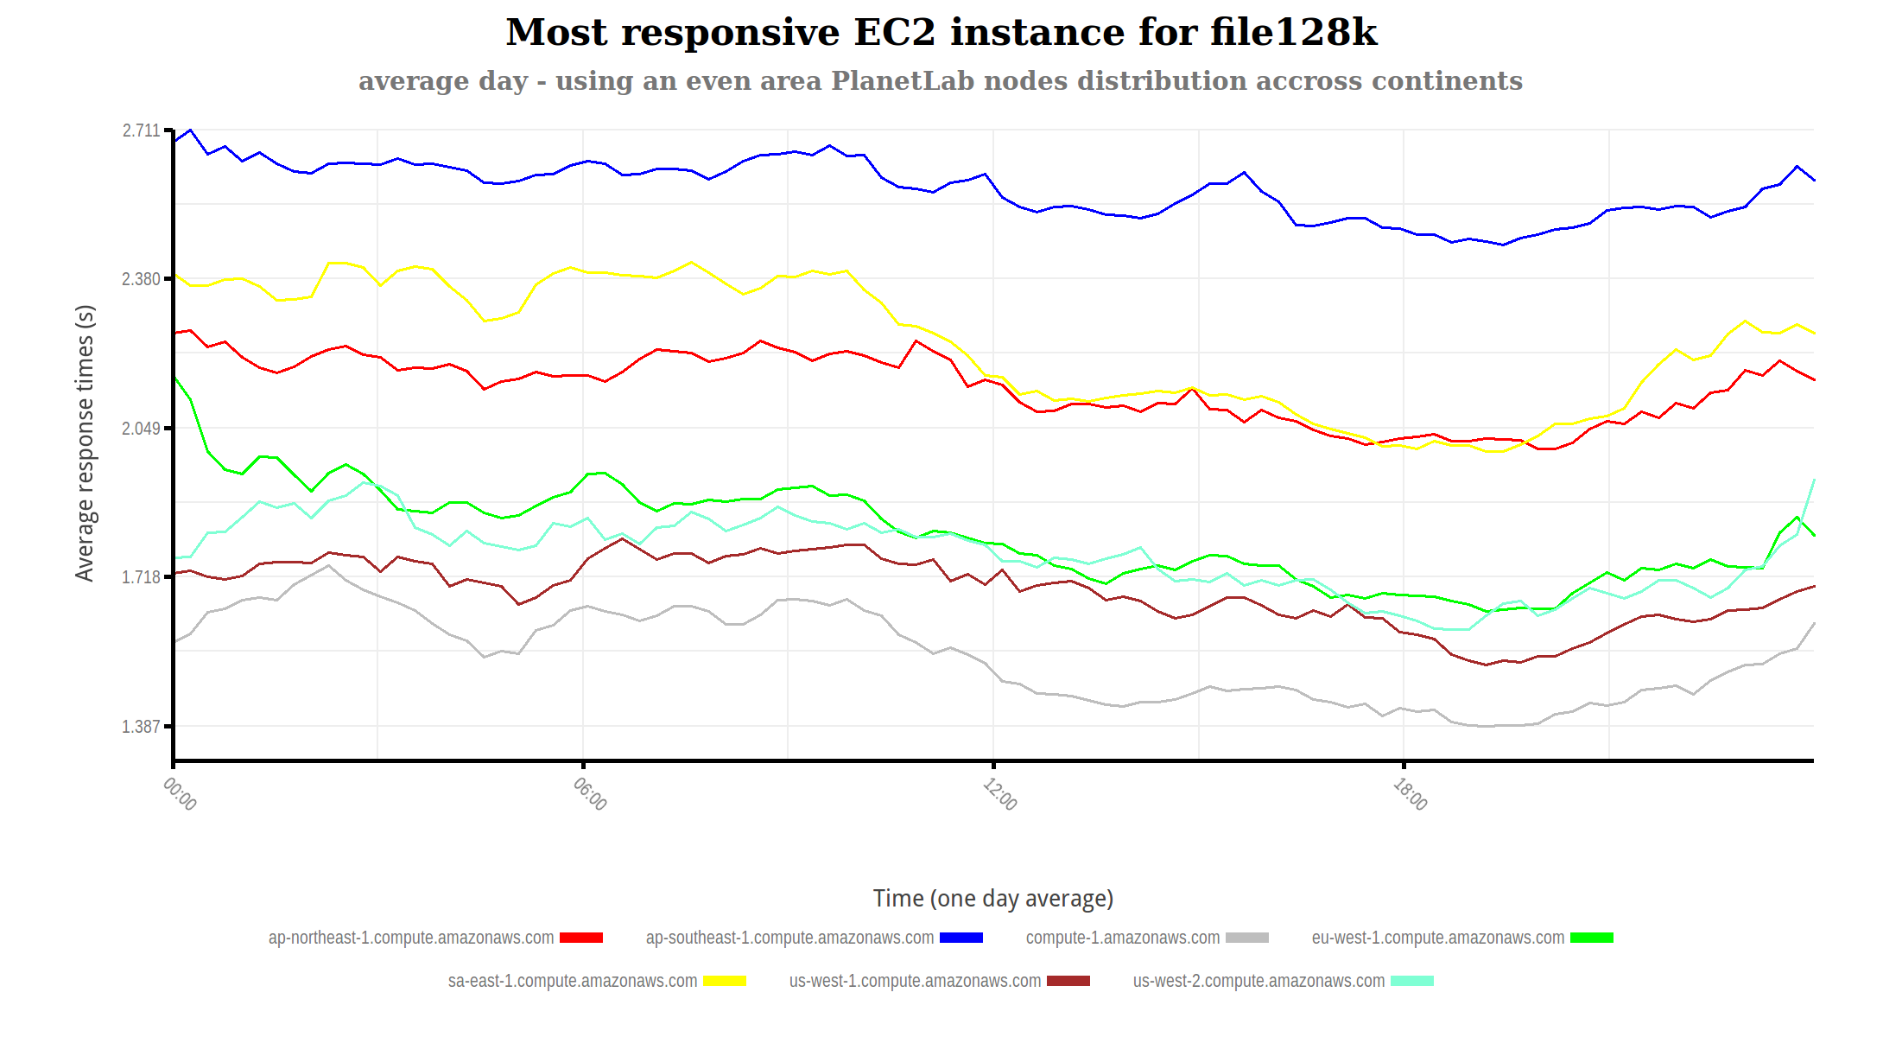
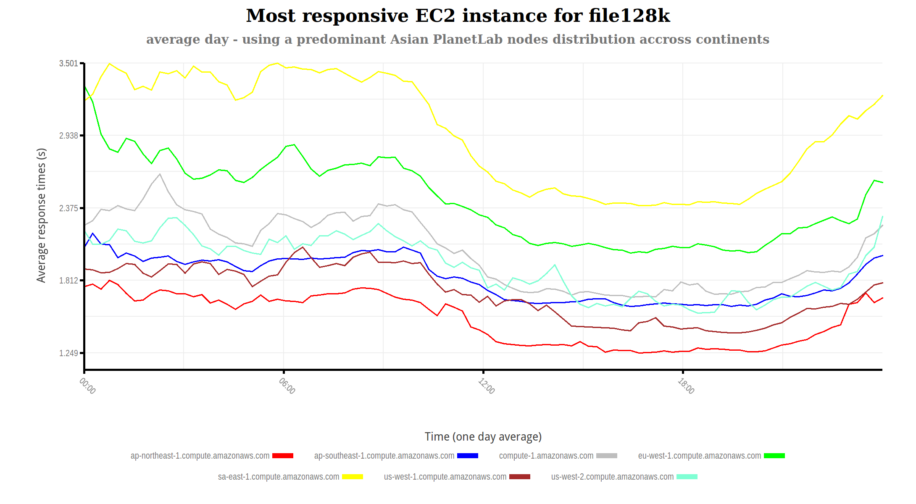
Even node distribution vs. 70% Asian

Slide 18
Model Creation
Algorithm created that predicts best instance and expected rate given location, day, and time
4 Linear Models fit and tested
Least Squares
Ridge Regression
Lasso
Elastic Net
Each model was given our collected data and our current location and provided the expected round trip time
We performed parameter tuning for Ridge, Lasso, and Elastic Net
Each was analyzed for it’s training and test error

Slide 19
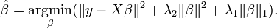
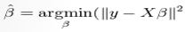
Model Selection
Linear Models – Y=XΒ + ε
Least Squares – best non-biased approximator, minimizes residual sum of squares
Ridge – Adds L2 norm penalty to Least Squares, reduces undesirable symptoms of correlated variables
Lasso – Adds L1 norm penalty to Least Squares, primary use is for variable/feature selection
Elastic Net – Adds L1 and L2 norm penalties getting both feature selection and reducing undesirable effects of correlated variables

Slide 20
Model Selection
Training and Test Error as Residual Sum of Squares
Model | Training Error | Test Error
Least Squares | 0.7530 | 0.8879
Ridge | 0.5304 | 0.5904
Lasso | 0.5304 | 0.5900
Elastic Net | 0.5304 | 0.5898
Elastic Net = Best Model

Slide 21
How much data do you need?

Slide 22
Location Planning
Given
projected measurements for a future period
presumed geographical user distribution
Where to place the EC2 instance?
cost
responsiveness
Additional input
Limit time between EC2 region migration to 3 hours
Express cost vs. responsiveness trade-off as a user specified max. cost

Slide 23
Lowering cost
Start with total cost for most responsive locations
While current cost > max. cost
For every 3 hour period quantify the opportunity of moving the instance to another region
opportunity cost = new region cost – old region cost
If opportunity cost > 0:
gain = new region’s avg response time – old region’s avg response time
Compute max(opp. cost / gain)
Migrate the instance for the corresponding period to the new region
You just lowered current cost by the opportunity cost

Slide 24
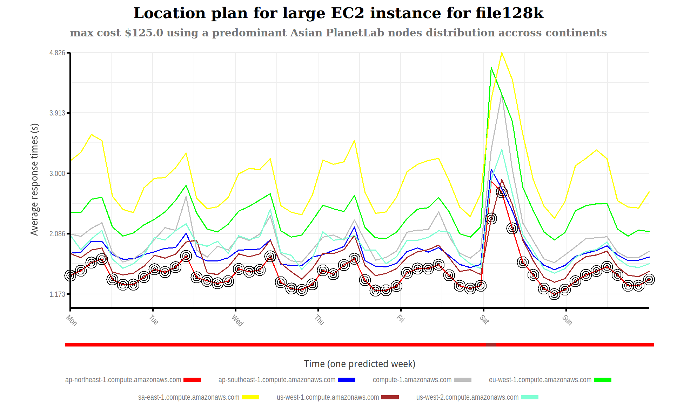
Plan for 70% Asian user base

Slide 25
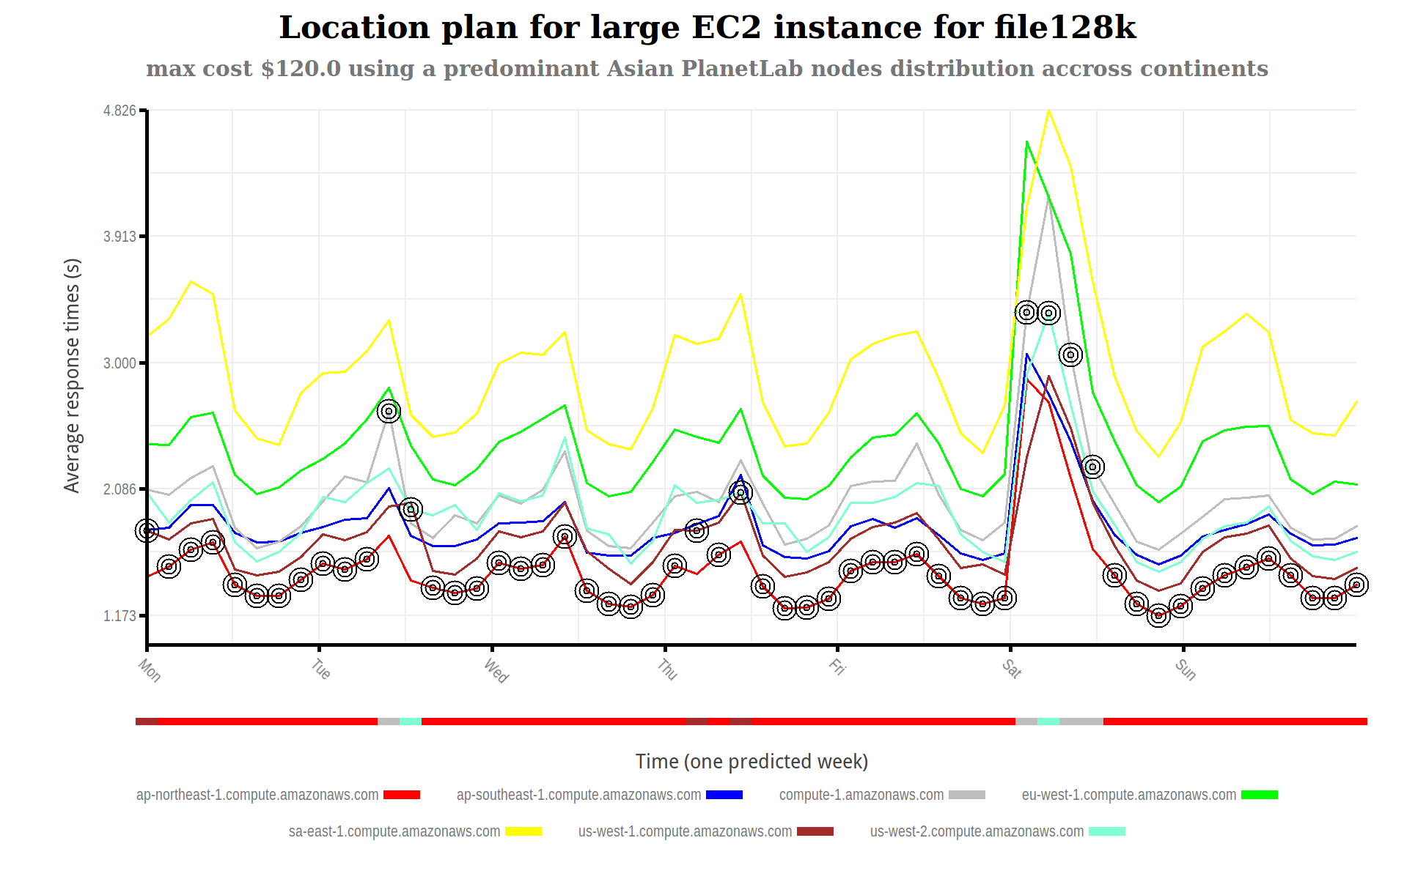
Plan for 70% Asian user base

Slide 26
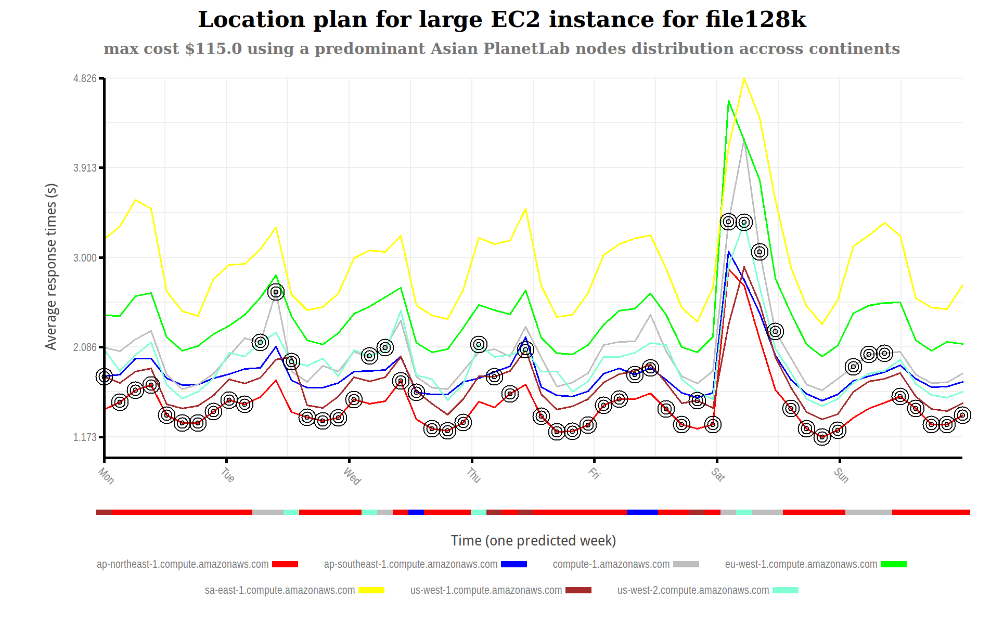
Plan for 70% Asian user base

Slide 27

Plan for 70% Asian user base

Slide 28
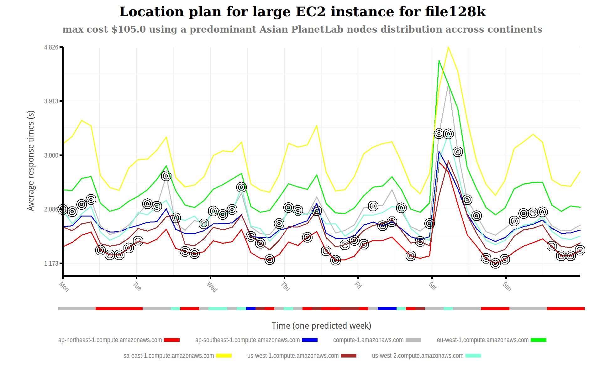
Plan for 70% Asian user base

Slide 29
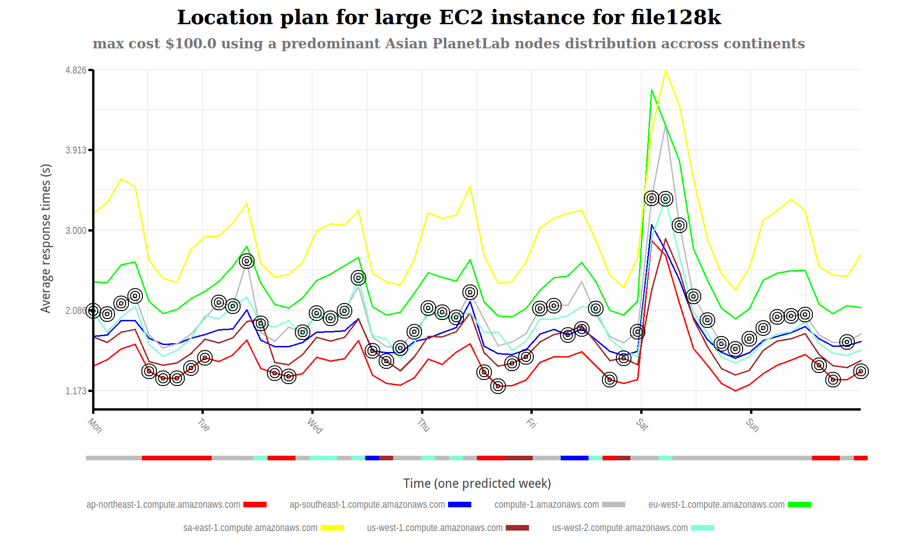
Plan for 70% Asian user base

Slide 30
Conclusions
Planning EC2 instance placement in 4 steps:
Collect set of response times
Redistribute user locations
Predict values for future period
Decide on maximum cost and run planner
Future work
Observe longer periods of time
Better location planning strategies (>1 EC2 instance)
Quantify cost vs. responsiveness tradeoff
tracepath?

